Slide 1
Module 4: Being a Facilitator
CBDRR Framework Training - Myanmar Red Cross Society
Session 1. Key Facilitation Skills

Slide 2
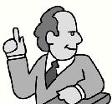

Session Objectives
At the end of this session, the participants will be able to
  use various methods of instructional communication
  make presentations as an individual and as a member of a team
  make use of the CBDRR Facilitators Guidebook

Slide 3

"Words for an Instructor to live by “ - SIX P’s
Plan
Content - Objectives, subject matter, key points
Visual aids - Should support presentation
Exercises - Should support the learning

Slide 4
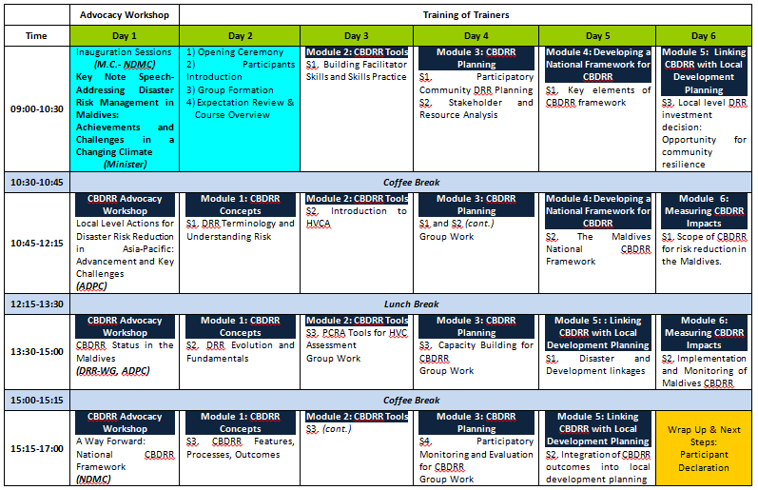
2. Prepare
Lesson plan - Road map/keeps you in sequence
Visual aids - Quality, well done, relevant
Practice - Physical run through with aids and equipment

Slide 5

3. Personal
Dress - Appropriate to audience, comfortable
Playthings - Jewellery, pointer, pens, money
Attitude - Positive, upbeat
Visualization - Practice in your mind
Perception - Individual, be on lookout - exercise

Slide 6

4. Presentation
Energy - Enthusiasm, positive, mean it
Style - Relax, natural
Activity - Movement, standing, sitting, rear of podium, notes, mike
Equipment - Know it, try it out, check, be prepared if it fails
Handouts - Give handout when appropriate

Slide 7
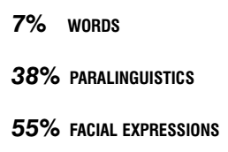
5. Presence
Voice - Monotone, inflection, speed,
Vocabulary - Know your audience, use the right words
Pace - Method of spacing out information, get feedback
Non-verbal - Feedback, 65%, use of hands, eyes, body
Communication - Filters, barriers
(Townsend, 1995)

Slide 8
6. Participation
Exercises - To reinforce learning, give feedback
Feedback - Positive feedback, reinforce learning, adjust presentation if necessary
Active listening - Reflection, paraphrasing, boomerang, ask questions
Giving instructions - Precise, concise, complete, all participants doing the same thing
FEEDBACK

Slide 9
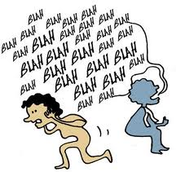
Communication Barriers
Rate of speech
  A rapid rate of speech may cause a loss understanding.
  A slow rate of speech may cause a
  loss of attention.
One way communication
  There is no feedback to the presenter
  to check for understanding.
  The typical lecture is an example. Information presented by technology, i.e.; audio and video tapes.

Slide 10
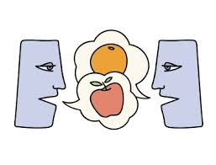
Cont’d
No feedback
  The presenter is unable to determine how well the information is being received.
  A class who doesn't want to be in the training may not provide feedback.
No visual contact
  Training using technology such as telephone or computer based lectures gives the instructor no non-verbal feedback.
No common language
  The scientist and the laymen, or the bureaucrat and the public. The use of jargon.
  The consultant who comes from another part
  of the country and does not "speak the
  language“ or understand the "culture".

Slide 11

Cont’d
No common frame of reference
  Different education or experiential levels.
  Different cultures or life styles.
Disorganization of ideas
  The presenter who speaks without notes or preparation.
  The presentation is just a group of random thoughts presented without continuity.
  Causes loss of understanding and induces frustration.
Too much information in a short time
  Same as a high rate of speech. Participants
  go into system overload.

Slide 12
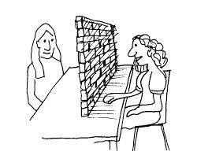
Cont’d
Redundancy
  Saying the same thing over and over again in different ways causes confusion and loss of understanding.
Frustration of communicators
  All of the above cause the presenter and the participant to become frustrated, which induces a new barrier that compounds the situation.

Slide 13
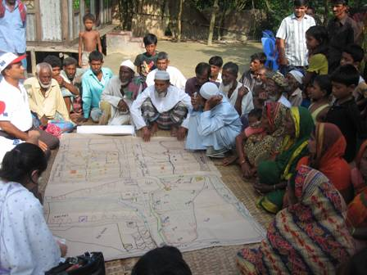
Applying Communication Skills to CBDRR Facilitation

Slide 14
Applying Communication Skills to CBDRR Facilitation (1)
Key Facilitation Skills for Participatory Development (VSO, n.d.)
Planning
Listening
Flexibility
Focus
Encouraging participation
Managing
Questioning
Promoting ownership
Building rapport
Self-awareness
Managing conflict
Broadening discussion
Presenting information

Slide 15
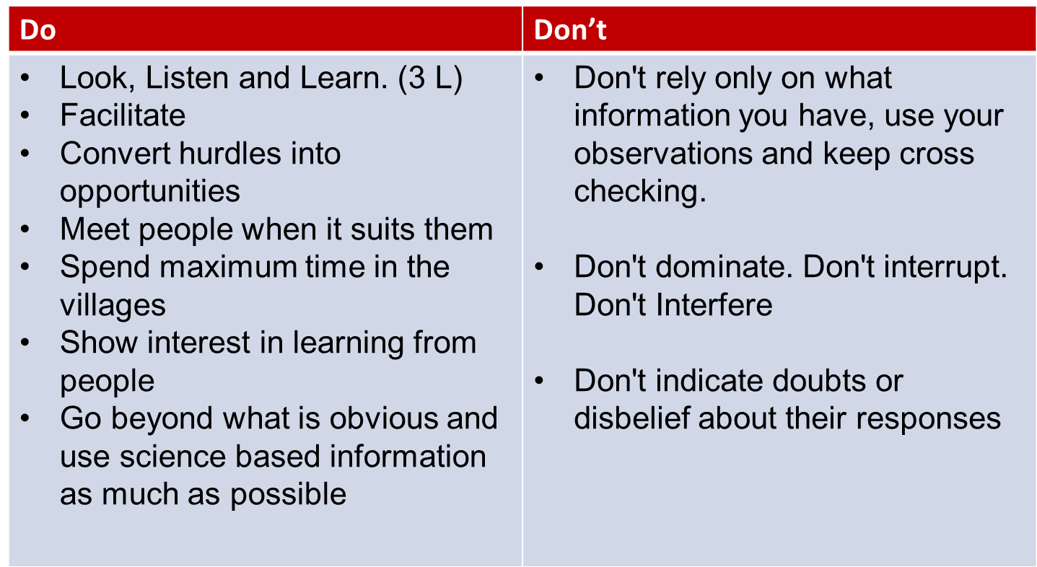
Applying Communication Skills to CBDRR Facilitation (2)
CBDRR Facilitation Tips

Slide 16
Group Exercise
Non-verbal | Meaning
Hands on hips | Aggressive-resistant & dominant.
Pointing finger | Aggressive-intimidating
Standing too close–getting in someone’s space | Aggressive
Thumbs in palms | Scared, nervous, insecure
Hugging body with arms | Passive, scared, closing self in to keep safe
Hand over heart | Sincerity
Chin stroking, head scratching | Signs of thoughtfulness
Arm around shoulder, index finger pointing on shoulder | May seem affectionate, but is a control device
Shrugging shoulders–dropped jaw, protruded head | May not understand what you are saying
Finger between nose and mouth | May not believe what you are saying, may not believe what is said.
Open palms | Openness, friendly
Covering mouth, pulls head back, narrows eyes | May warn speaker to step back or speak less loudly
Covering mouth when speaking | Passive, unsure about what is being said
Frowning | Disapproving what is happening, may not under-stand
Hand over nose and mouth | May indicate a negative evaluation
Fist in the air | Power, success

Slide 17
Non-verbal | Meaning
Punches own palms | Wants to emphasize–may be indicator of stress-full situation he is talking about
When in a group having hand on your hip | May be warding off people on that side
Sitting turned away | Uncomfortable in that persons presence.
Sitting turned towards someone | Openness
Shoulders down–slumping | Passiveness
Moving from slump to more erect stance sucking in belly, squaring shoulders (most evident in men) | Wanting to make an impression
Covering or rubbing eyes | Refusing to accept something
Narrowing of eyes | Suspicious
Rubbing hand between eyes | May be uncomfortable with subject matter
Looking down | Going to a feeling state
Staring at floor | Passive, insecure
Shutting eyes and pointing | “If you can’t see the wisdom of this, then you really are naive.”
Blinking rapidly, shutting eyes when speaking | Going deep inside for information
Open, direct, good eye contact without staring | Assertive
Staring expressionless | Aggressive

Slide 18
Let’s consider how we apply these skills during the CBDRR process…
Initiating the work with community
Building Rapport & Understanding the Community
Participatory Community Risk Assessment
Participatory Risk Reduction Planning
Community Managed Implementation
Participatory Monitoring and Evaluation.

Slide 19

Any Questions?

