Slide 1
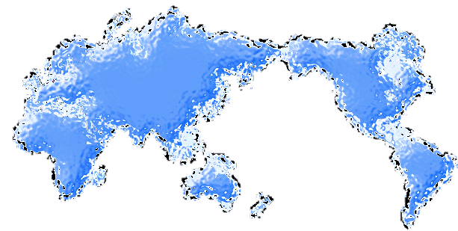
LABOUR MIGRATION AND PROTECTION CHALLENGES
The RCRC perspective

Slide 2
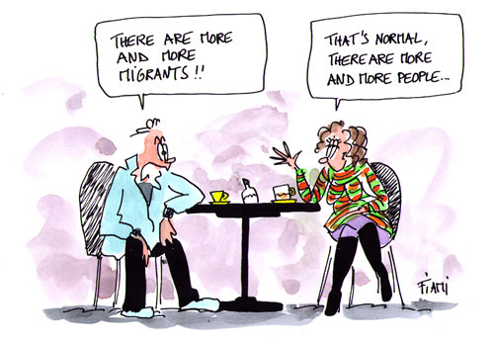
Notes:
Do you know that there are more migrants than ever because of the growing world population? The absolute number of people migrating has risen from 154 million in 1990 to 232 million in 2013, yet for many years migrants have made up about 3% of the world's population.

Slide 3
International convention:
In December 1990, the GA adopted
the International Convention on the Protection of the Rights of All Migrant Workers and members of Their Families
and it as opened for signature by all Member States.
The Convention entered into force on
1 July 2003

Slide 4
Scope
Defines the rights of migrant workers before departure, in transit, and in the country of employment
Establishes obligations for countries of origin, transit, and employment

Slide 5
International Human Right law:
IHRL protects all persons regardless of nationality or legal status
But elaboration of this principle in more detailed instruments not widely accepted
Violations of migrants’ human rights continue (not only for labour migrants’ human rights)
Legal and practical problems in accessing economic and social rights
Notes:
Duplication of work and gaps in tackling other areas (social protection, medical services, access of migrants’ children to education)

Slide 6
Migrant workers-specific rights
Effective protection by the State against violence, physical injury, threats and intimidation – Art 16(2)
Prohibition on confiscation and destruction of identity and travel documents (e.g. passports) – Art 21
Recourse to protection and assistance of consular/ diplomatic authorities of State of origin – Art 23
Transfer of earnings and savings (i.e. remittances) – Art 32
Free provision of information on Convention rights and conditions of admission and, as far as possible, in a language migrants can understand – Art 33

Slide 7
Principles of Migrant Workers protection
Human rights are inalienable – basic principle of non discrimination
Derogation possible in times of emergency
Human rights instruments make some distinctions between national and non-nationals, regular and irregular migrants

Slide 8
Three problematic areas for protection
Principle of equality and non-discrimination
To what extent does this principle apply to non-citizens, particularly non-discrimination on the grounds of nationality?
Economic and social rights
Are these rights equally and fully applicable to non-citizens?
Can irregular migrants expect equivalent protection to regular migrants and/or nationals in both law and practice?
Irregular migration

Slide 9
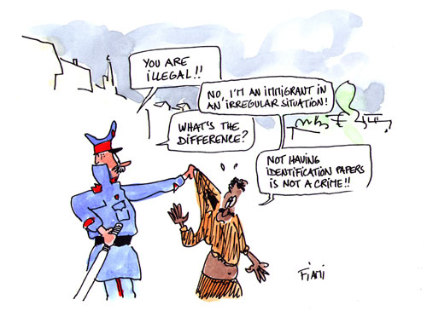
Notes:
Do you know the difference between “illegal migration” and “migrants in an irregular situation”? Irregular entries, stay and work are not criminal offences but administrative misdemeanours. Not distinguishing between the two terms reinforces the false and negative stereotype that migrants in irregular situations are criminals.

Slide 10
Protection of irregular migrants
“Illegal”
Connotations with criminality
Invisibility under the law?
Right of everyone to recognition everywhere as a person before the law (UDHR, Art 6)
“Irregular”

Slide 11
UN General Assembly Resolution 1975
“Requests the United Nations organs and the specialized agencies concerned to utilize in all official documents the term 'non-documented or irregular migrant workers' to define those workers that illegally and/or surreptitiously enter another country to obtain work” (para. 3449, 2)

Slide 12
`Protection in action`
We can work together to change perceptions of migrant workers;
There is a need to present the human story rather than faceless statistics;
Terminology is important; we need to get it right;
Ensuring migrant voices are heard by involving migrant workers in migration programmes and initiatives;
Positive engagement with Media, including encouraging timely publication of accurate data and use of data;
Linking government and civil society actions in sending and receiving countries
Improving inks between local communities, migrant worker and other partners).

Slide 13
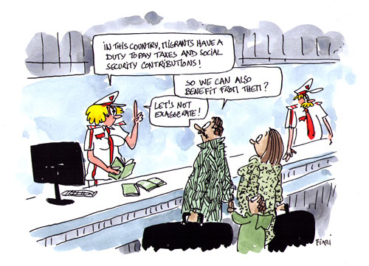
Notes:
Do you know that everyone – migrant or not – has a right to social security? Many do not recognize the contributions all migrants – including migrants in irregular situations – make to the economy and to social security schemes where they live.

Slide 14
What more can we as do to better highlight protection challenges and appropriate responses under international law….
cg

