Slide 1
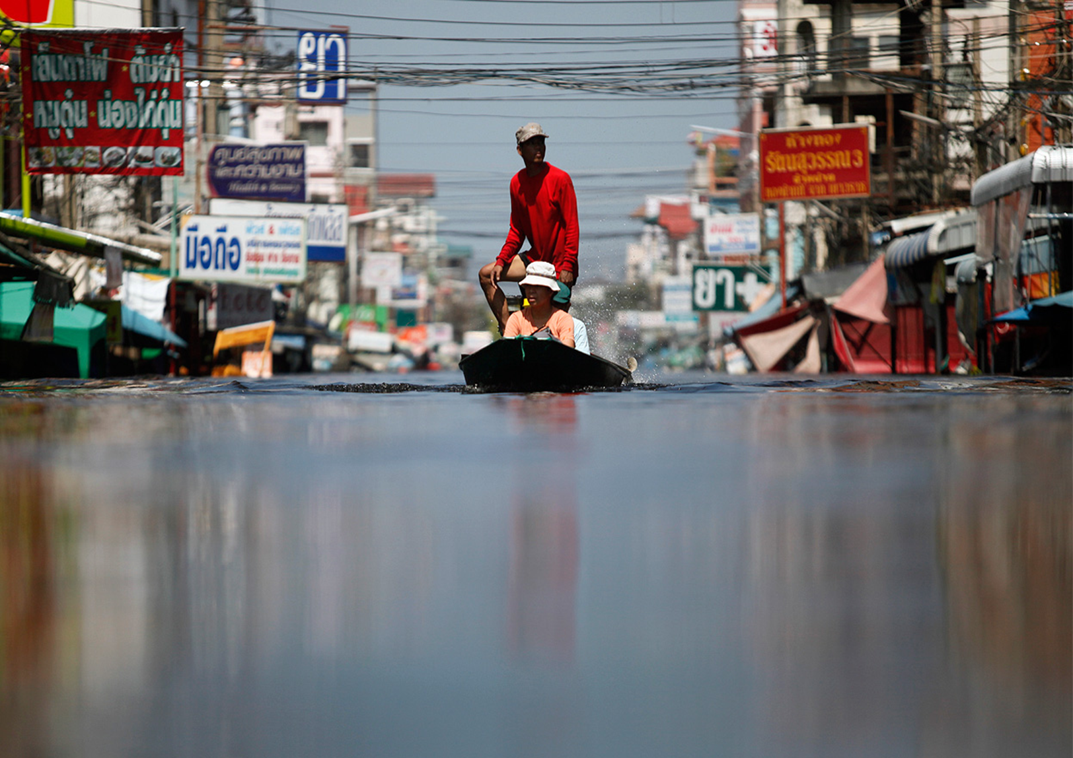
Disaster Law: An Asia Pacific Perspective
Introduction to Disaster Law – Part 2
ACE Programme 2015

Slide 2
Overview of the session: Part 2
Theme 2: Law and DRR
Disaster Law developments in South East Asia and role of RCRC
Country case study: Indonesia
Background, multi-country study, DRR checklist
Wrap up, questions, comments

Slide 3
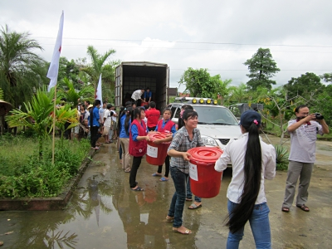
Why law and DRR? Experience highlights the importance of legal frameworks for DRR
Vietnam:
Seen the benefits of having strong laws / regulations for DRR in terms of saving lives.
Legislation on early warning, the establishment of dykes, drains (prevent flooding) and safe shelters and community awareness activities = a substantial reduction in lives lost from flooding and storms.
The flood level in the Mekong Delta in 2011 was similar to 2000 BUT the number of deaths from floods dropped from 600 down to 60.

Slide 4
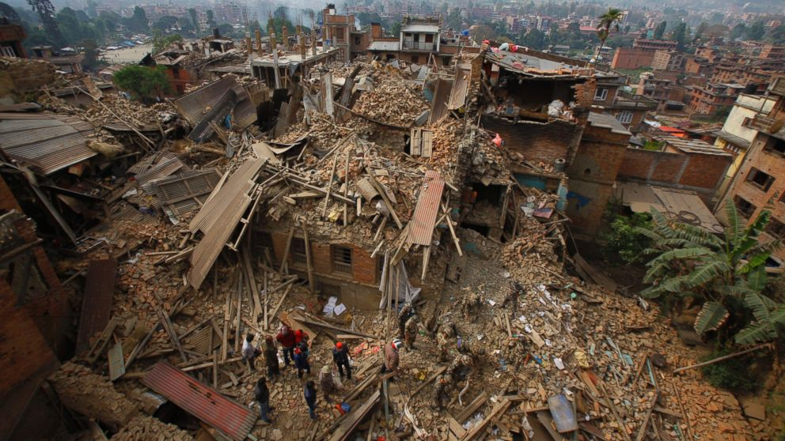

Slide 5
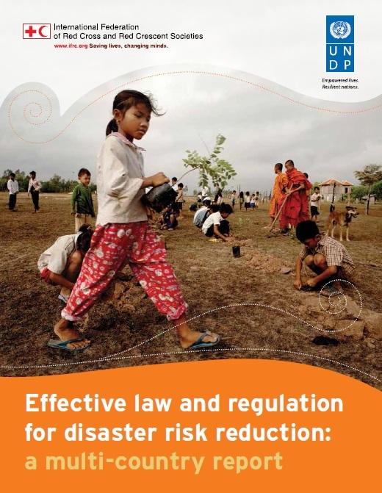
What has IFRC been doing to address this?
Multi-Country Report
IFRC and UNDP launched a global study in 2014 looking at 31 countries:
Examples of good practice legal provisions
What helps or hinders implementation
Recommendations for reviewing or drafting laws
Aim to support legislators, public administrators and development practitioners to prepare and implement legal frameworks for DRR

Slide 6
Findings: Role of Disaster Risk Management laws
DRM law
DRR as a priority in law and policies
Support DRR education and awareness
Provide budget allocation for DRR
Define roles and responsibilities at different levels

Slide 7
Findings: sectoral laws are equally important!
Building codes
Land Use planning
Environment
Development approvals
Climate change adaptation
Mainstreaming DRR

Slide 8
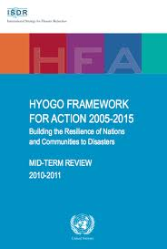
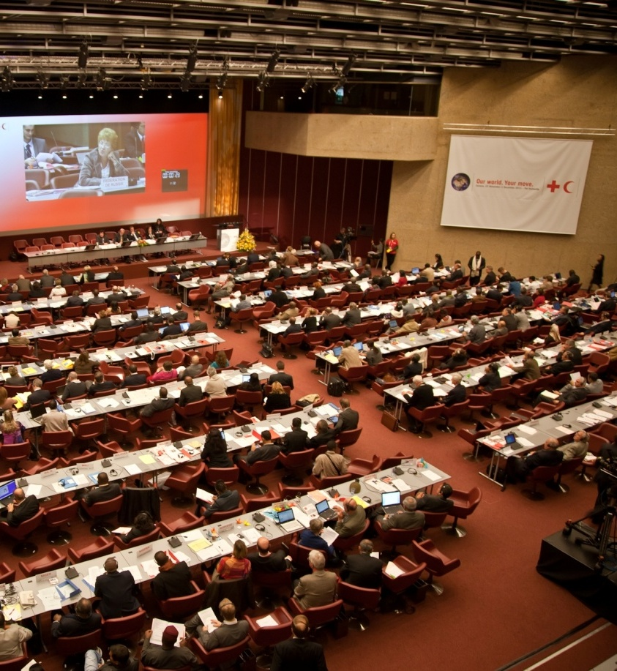
Background: where did this idea come from?
  HFA Priority 1 – DRR – a national and local priority through: “policy, legislative and institutional frameworks for disaster risk reduction”
  Resolution 7 - International Conference of the Red Cross and Red Crescent in 2011 – calls on states to review existing legal frameworks for DRR

Slide 9
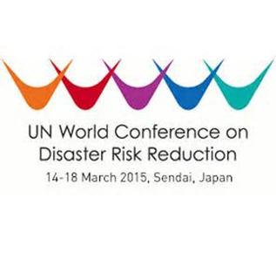

Disaster Law: International Commitments
Sendai Framework for DRR: focus on DRR legislation and IDRL Guidelines
Resolution and Pledges on Disaster Law

Slide 10
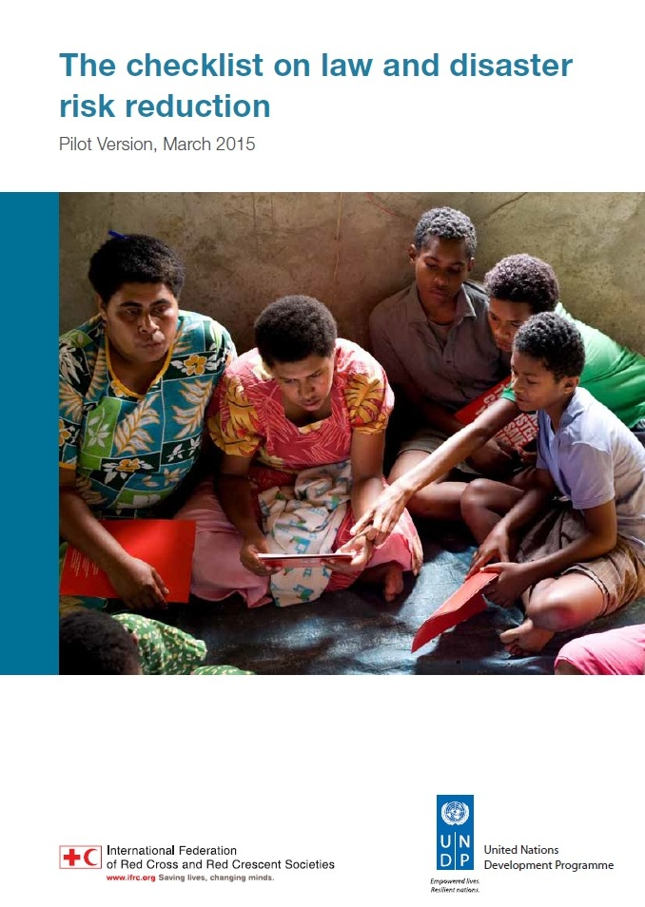
Next steps: The Checklist on Law and DRR
A succinct and easy to use tool to support the strengthening of legal frameworks for DRR by:
    Drawing on key findings of the multi-country study
    To help guide a review and revision process of laws and regulations for DRR
    For use by lawmakers, NDMOs, RCRC Societies, other DRR advocates
    Handbook being drafted to guide implementation of the checklist

Slide 11
True or False?
If you have a good disaster management law, your legal framework for DRR is complete
Answer: False

Slide 12

Key points to remember!
Disaster management laws are important: BUT other sectoral laws are equally as important for risk reduction
Effective laws and regulations serve as a foundation for building community resilience and making people safer
The Checklist on Law and Disaster Risk Reduction will provide guidance for reviewing and improving legal frameworks for DRR

Slide 13
What is the role of the IFRC’s Disaster Law Programme?
Technical assistance
Advocacy
Research and capacity building

Slide 14

What is the role of National Societies in Disaster law?
Auxiliary role = bridge between community and national level law and policy-making processes
2011 International Conference: SEA National Societies made a joint pledge to work with governments to strengthen disaster laws – some governments made pledges too!
32nd International Conference in December 2015: sign a new regional pledge or joint pledge with government. SEA NS Leaders have committed to this – governments can do the same!

Slide 15
Disaster Law Work in Southeast Asia
Working with DFA and Congress on new bill & review of DM law
Philippines
Cambodia
Indonesia
Thailand
Vietnam
Myanmar
Lao PDR
IDRL study, Developing new DM law
IDRL workshop – Int. Asst. Guideline
IDRL Study, DM law review, DL roadmap
IDRL and DRR study, comments on law
IDRL Study,
Developing new DM law
New DM law and rules, high level workshop
IDRL study

Slide 16
What disaster law work have SEA National Societies been doing?
Malaysia
Singapore
Brunei Darussalam
National workshop on (legal) preparedness with govt and OCHA
Contribute to regional initiatives
Sensitization and enhancing relations with government

Slide 17
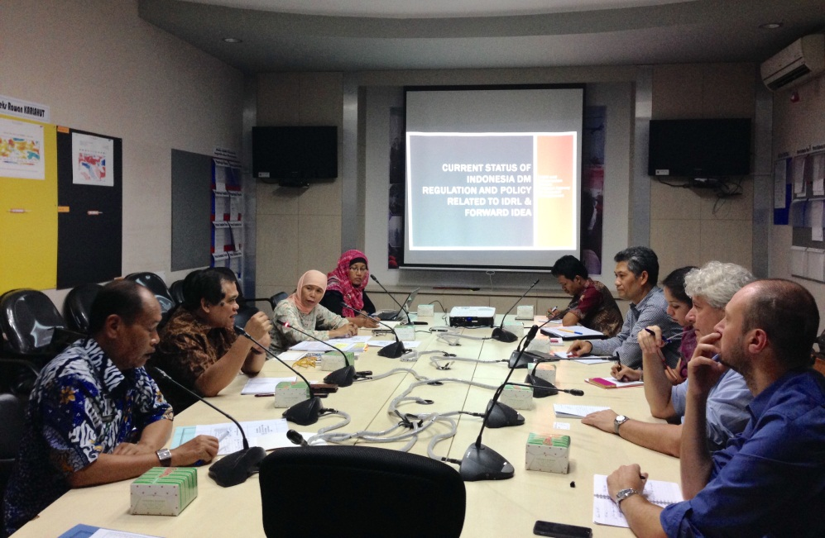
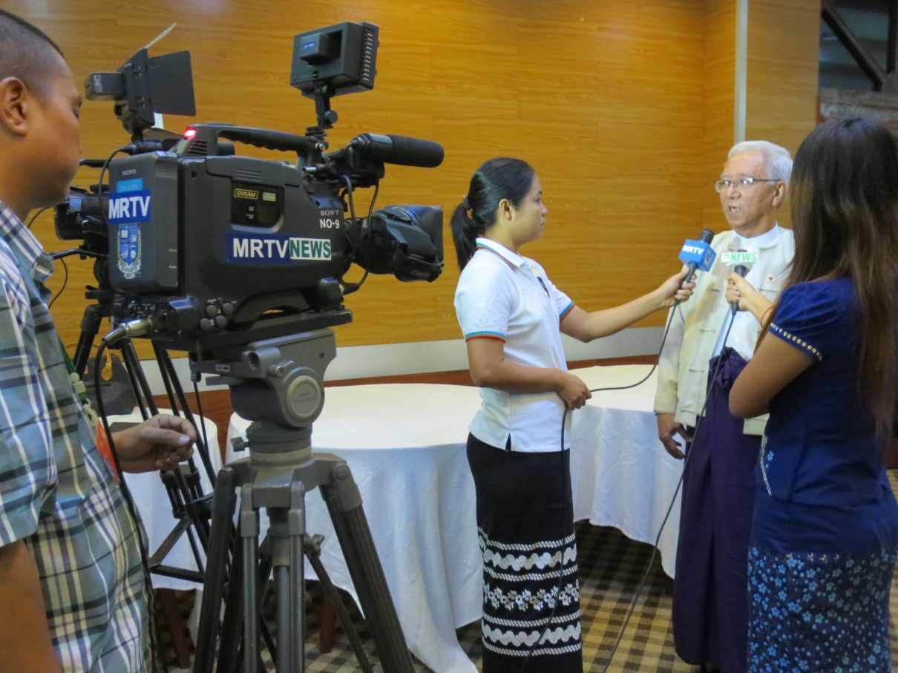
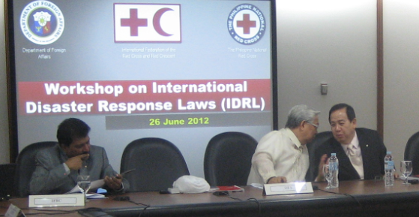
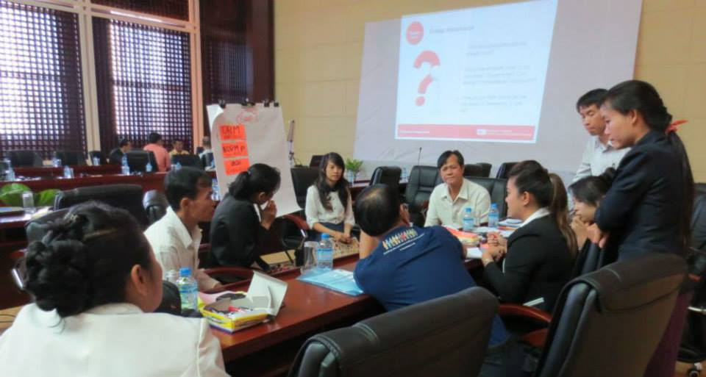
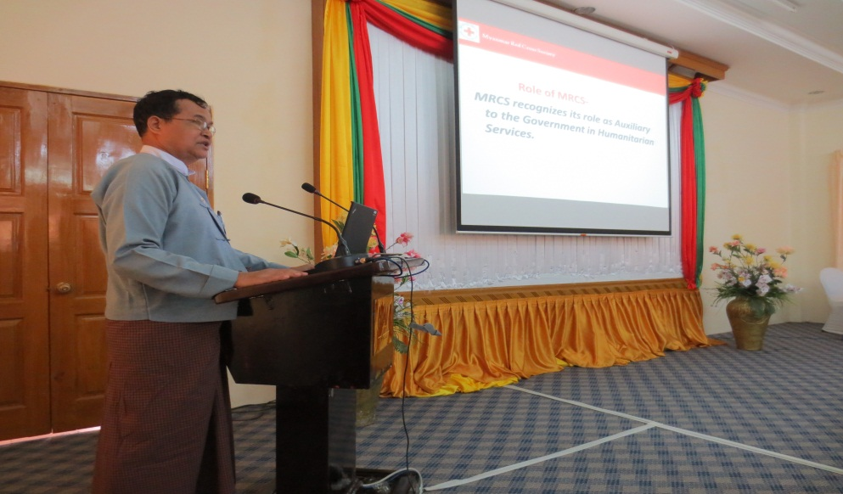
South East Asia: Leaders in Disaster Law!

Slide 18

Thank you!
Comments?
Questions?

