Slide 1
Dignity, Access, Participation and Safety of people with disabilities
SEA Regional Gender and Diversity
Training of Trainers
5-8th October

Slide 2
Session learning objectives
(please included the results from your SMART objectives exercise)

Slide 3
What is disability?
Disability is complex and multidimensional
No two people with a disability will have the same experiences
Disability is being recognised more and more, not only as the condition itself, but the interaction between:
The person with the impairment and
The enabling or disabling characteristics of his or her environment.

Slide 4
What is disability?
Visual
Intellectual
Physical
Auditory
The way a disability or impairment will impact a person will depend on the support available, the barriers facing the individual and the context.
It will also be very dependent on the person and their individual capacity

Slide 5
What is disability?
The IFRC uses a definition in line with the UN Convention on the Rights of Persons with Disabilities which considers:
‘persons with disabilities’ to include “those who have physical, mental, intellectual or sensory impairments, which, in interaction with various barriers, may hinder their full and effective participation in society on an equal basis with others”
Notes:
Sourced from: Council of Delegates of the International Red Cross and Red Crescent Movement Geneva, Switzerland 7 December 2015 Draft “0” Resolution on “Adoption of the Disability Inclusion Strategic Framework by the International Red Cross and Red Crescent Movement”
http://rcrcconference.org/wp-content/uploads/sites/3/2015/03/CoD15_disability_draft-0-resolution_20150916-EN.pdf

Slide 6
Impacts of disaster on people with disabilities
We know that people have different needs and capacities before, during and after a disaster.
People with disabilities may also have the same needs as people without disabilities, but they may require specific support to ensure equal access this need.
Disasters can make people vulnerable, but without adequate and appropriate support, disasters can have a more pronounced impact on the vulnerability of people with disabilities.

Slide 7
Risk factors for people with disabilities can include….
Environmental: Physical infrastructure can be a barrier e.g. poor lighting and narrow evacuation routes. A disaster can also lead to additional, unpredicted physical barriers.
The environment can also be problematic if people loose or lack mobility aids or do not have proper assistance.
This can lead to people with disabilities being deprived from rescue and evacuation services, relief, safe location/ adequate shelter, water and sanitation and other services
Notes:
Adapted from Handicap International (2005). How to include disability issues in disaster management following floods 2004 in Bangladesh. http://www.handicap-international.de/fileadmin/redaktion/pdf/disability_management.pdf

Slide 8
Risk factors for people with disabilities can include….
Access to information: Information that cannot be accessed through different methods can exclude people with disabilities from essential communication channels. In addition to different methods, everyone, including people with disabilities should be trained on information dissemination systems
Lack of awareness: this can cause difficulties if the person’s impairment or disability reduces their understanding of the situation and the consequences of the disaster
A lack of awareness of the support a person may need can also contribute to vulnerabilities.
Notes:
Adapted from Handicap International (2005). How to include disability issues in disaster management following floods 2004 in Bangladesh. http://www.handicap-international.de/fileadmin/redaktion/pdf/disability_management.pdf

Slide 9
The importance of inclusive programming
People with disabilities are equal members of the community with equal rights.
People with disabilities will also have a unique perception of the environment around them which can provide essential information on the barriers they may be confronted with during an disaster and the most appropriate ways they can be supported.
Therefore it should be ensured that people with disabilities participate in community-based activities to ensure their needs are met.

Slide 10
Interaction between gender and disability
Disability is gendered, with more women than men living with mental or physical disabilities.
On average, women live longer than men, so they experience more disabilities related with old age
The late stages of pregnancy, childbirth and the aftermath can also have an impact, limiting women’s personal mobility.
Rates of mental illness are known to be higher among women e.g. depression. Reduction in social networks following a disaster can exacerbate this risk.
Notes:
Adapted from: Council of Delegates of the International Red Cross and Red Crescent Movement Geneva, Switzerland 7 December 2015 Draft “0” Resolution on “Adoption of the Disability Inclusion Strategic Framework by the International Red Cross and Red Crescent Movement”
http://rcrcconference.org/wp-content/uploads/sites/3/2015/03/CoD15_disability_draft-0-resolution_20150916-EN.pdf
And IFRC’s Gender and Diversity for Urban Resilience: An analysis https://www.dropbox.com/s/ibgv139gi9kcnyo/Urban%20DRR_Final.pdf?dl=0

Slide 11
Interaction between gender and disability
Many inter-related factors, such as abuse of power, poverty, gender inequality or discrimination and substance abuse combine to create increased vulnerability.
In patriarchal societies these interactions can cause increased risks for women and girls.
As a result, women and girls with disabilities are often recognised as having multiple vulnerabilities.
Notes:
Adapted from Buscher, D. Humanitarian Practice Network (HPN), Humanitarian Exchange, No. 60, February 2014, Special Feature on Gender-based Violence in Emergencies, Preventing Gender-based Violence: Getting it Right.
And Council of Delegates of the International Red Cross and Red Crescent Movement Geneva, Switzerland 7 December 2015 Draft “0” Resolution on “Adoption of the Disability Inclusion Strategic Framework by the International Red Cross and Red Crescent Movement”
http://rcrcconference.org/wp-content/uploads/sites/3/2015/03/CoD15_disability_draft-0-resolution_20150916-EN.pdf

Slide 12
Interaction between gender and disability
Not only people with disabilities are affected, but people who assist or care for people with disabilities can also be affected due to restrictions and limitations caused by disability.
In cultures/societies where women take the role of the homemaker and take care of children, elderly and/or disabled relatives, this can increase the vulnerability of women during disasters.

Slide 13
Disability and violence
Violence is both a cause and an increased risk factor of disability.
Interpersonal violence constitutes a significant factor in the incidence and prevalence of impairments across the world.
Women and girls with disabilities are 4 to 10 times more likely to experience gender-based violence than women and children without disabilities.
Violence against children with disabilities occurs at annual rates of at least 1.7 times greater than for the rest of their peers without disabilities
Notes:
Adapted from Council of Delegates of the International Red Cross and Red Crescent Movement Geneva, Switzerland 7 December 2015 Draft “0” Resolution on “Adoption of the Disability Inclusion Strategic Framework by the International Red Cross and Red Crescent Movement”
http://rcrcconference.org/wp-content/uploads/sites/3/2015/03/CoD15_disability_draft-0-resolution_20150916-EN.pdf

Slide 14
What can we do?
Actively consider the needs of people with disabilities before, during, and after disasters
Make special efforts to identify, locate, register, and follow-up with people with disabilities and other vulnerable groups.
Never make assumptions: Include specific questions about disability issues in all of your assessments
Sensitise staff to ways of mainstreaming people with disabilities

Slide 15
What can we do?
Ensure people with disabilities are key stakeholder in decision-making processes in preparedness and response plans to ensure equitable and effective programming.
If necessary take special measures to ensure people with disabilities can be included.
Increase awareness of, and actively work to reduce gender inequalities
Connect with local groups that work with people with disabilities to create support networks and provide specialised support if required during a disasters

Slide 16
Conclusion
Please add your own groups conclusion

Slide 17
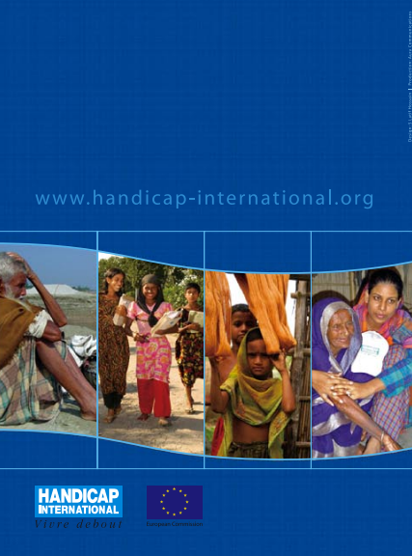
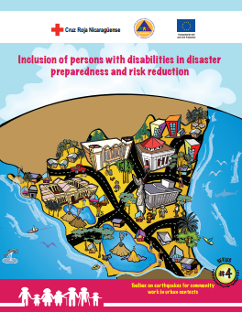
Gender and Diversity for Resilience Resource Library
For internal and external resources on inclusion of people with disabilities follow this link:
Link:
https://sites.google.com/site/drrtoolsinsoutheastasia/gender-and-diversity/gender-and-diversity-for-resilience-toolkit/building-resilience/disaster-risk-reduction-drr---disaster-management-dm

Slide 18

Any questions?

