Slide 1
Dignity, Access, Participation and Safety of the Elderly
SEA Regional Gender and Diversity
Training of Trainers
5-8th October

Slide 2
Session learning objectives
By the end of the session, participants will be able
to recognize the vulnerabilities and to identify the capacity of the elderlies
to suggest ways in which the elderlies could participate in the disaster management program of the National Societies.

Slide 3
Aging populations
In Southeast Asia, and globally there are a number of countries that have increasing aging populations.
We know that disasters impact people in different ways and they will have different needs during and after an emergency.
The elderly are one of the most vulnerable groups in disasters.

Slide 4
DOCUMENTARY
PART 1

Slide 5
Group Work
3 minutes discussions
i. Vulnerabilities of the elderly in disaster
ii. How they can contribute in Disaster Management
4 groups : choose a rapporteur from each group
Notes:
References: (Who is vulnerable to Tsunami, UNESCAP)
Data from japan was taken from three of the divisions surveyed.

Slide 6
DOCUMENTARY
PART 2

Slide 7
Main points from the documentary
Vietnam
60 yrs old and above – 10% of the population
73% - rural / isolated areas & no children or others to care for them.
65% of human loss during disasters.
Japan Tsunami
70% of victims are elderlies

Slide 8
Vulnerability factors of the elderly during disasters
There are a number of factors that increase the vulnerability of the elderly to disasters:
Directions to the evacuation sites
Could not withstand long term disaster
Exclusion / isolated in rural areas

Slide 9
Vulnerability factors of the elderlies during disasters
Older people get weaker and slower and are more likely to have complications with their health
Older people may lack mobility, hearing, sight and are therefore would be more dependent on assistance
Elderly people with disabilities, can be even more prone to vulnerabilities (this highlights another interaction between aspects of diversity)

Slide 10
Manners in which the elderlies can assist the community and the National Societies
Resourcefulness due to years of experience
Decision making
Control of assets
Community projects
Help in the evacuation activities
Transfer of food.
Many may have lived through disasters before and understand the pattern of disasters
Experience of building up effective coping strategies or survival systems during and after disasters

Slide 11
Manners in which the elderlies can assist the community and the National Societies
Knowledge of traditional or alternative medicines, which can be vital to the development of the community
In some communities the elderly may have control over household assets and therefore play a key role in building back livelihoods
Elderly members of the community may be the main decision makers

Slide 12
What can we do ...
Before a disaster, include the elderly in all disaster preparedness and disaster risk reduction activities e.g. mapping, analysis, planning, implementation and reporting
Encourage staff and volunteers to view older people in the community as having capacities and develop processes to harness and build on these capacities
After a disaster, ensure elderly people can access evacuation centers and that they can attend relief distribution points. It is important to make provisions to reduce barriers to this.

Slide 13
What can we do ...
Important step to take during disaster
- Assessment needs to be carried out
- Elderlies’ need were not excluded before and during disaster
.

Slide 14
Conclusion
Elderlies are valuable part of the communities and National Societies
One of the vulnerable groups that must not be neglected.
They must be socially included in every phase from planning to implementation.
They are assets of the community.

Slide 15
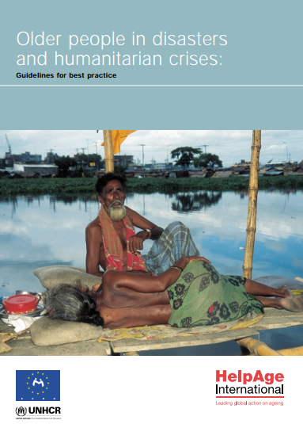
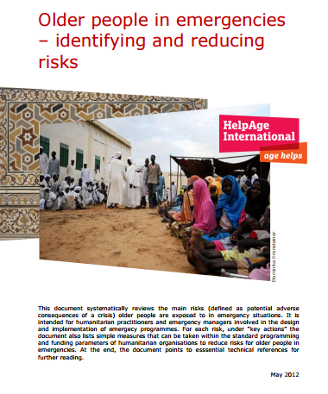
Gender and Diversity for Resilience Resource Library
For internal and external resources on inclusion of the elderly in DRR/DM follow this link:
Link:
https://sites.google.com/site/drrtoolsinsoutheastasia/gender-and-diversity/gender-and-diversity-for-resilience-toolkit/building-resilience/disaster-risk-reduction-drr---disaster-management-dm

Slide 16
Any questions?

Slide 17
THANK YOU ☺

