Slide 1
First SEA Regional Gender and Diversity Teleconference
10 September 2015

Slide 2
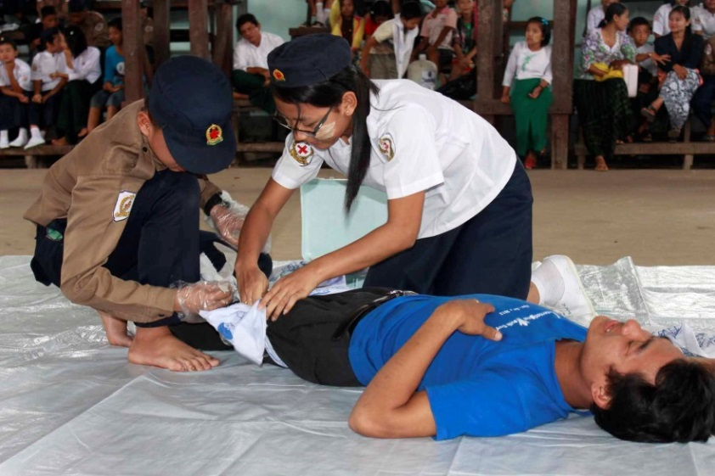
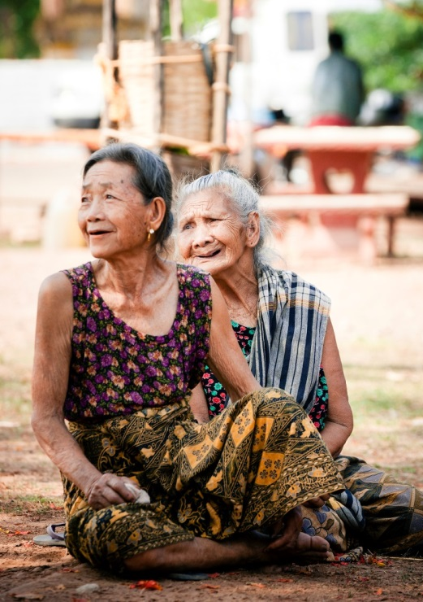
Meeting Objectives
Introduction of Network Members
Share National Society current gender and diversity initiatives or plans
To provide an overview of the SEA Regional Gender and Diversity Network
To provide an opportunity for Q&A
Overview of SEA Regional Training of Trainers and Annual Gender and Diversity Network meeting
Overview of the process of election of a chairperson

Slide 3
Introductions…
Datin Hajah Siti
(Brunei Darussalam)
Mr. You Lana (Cambodia)
Ms Ket Keo (Laos)
Mr Saiful Nordin (Malaysia)
Daw Khin Khin Shein (Myanmar)
Ms Norwina Eclarinal (Philippines)
Ms Anne Tampubolon (PMI)
Khun Chamnong (Thailand)
Ms Quy (Vietnam)
Ms Charis Chan (Singapore)

Slide 4
Regional Gender and Diversity Network
Ten Gender and Diversity Focal Points
First annual Southeast Asia Regional Gender and Diversity Network Forum
(November 2014)
TOR presented at the 12th Annual Southeast Asia RCRC Leadership Meeting
(February 2015)
Endorsement of the SEA Regional Gender and Diversity Network
(May-July 2015)
Identification of National Society Gender and Diversity Focal Points
(May – July 2015)

Slide 5
Regional Gender and Diversity Network
Aims to…
Build stronger collaboration
Knowledge and capacity building
Encourage and enable peer-to-peer support
Co-ordinated regional approach
Promote the gender and diversity work of NSs
Enhance strategic direction
Quarterly teleconferences
Annual meetings – 9th October 2015
Chairperson
Regular communication updates

Slide 6
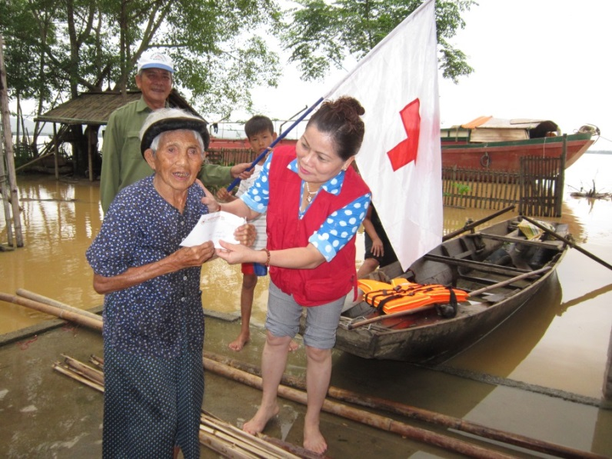
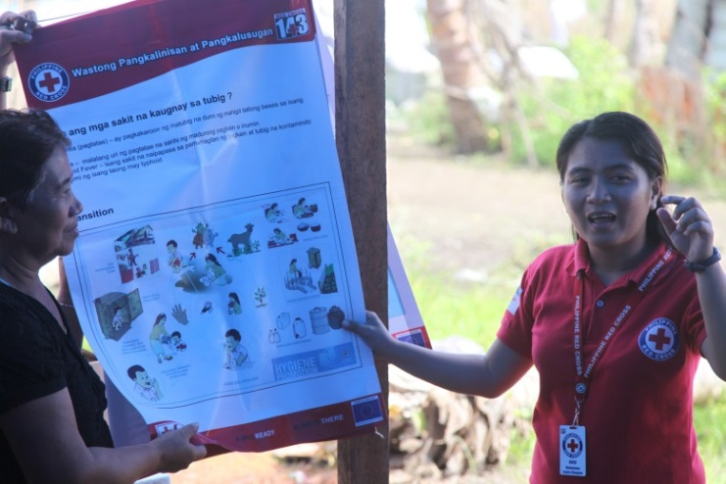
National Society Gender and Diversity Focal Points
To promote and assist in mainstreaming of gender and diversity
Provide technical assistance to National Society members on gender and diversity
Engage in peer-to-peer support through regional networks
As well as strengthening networks at a National level

Slide 7
Open discussion….
Suggestions
Ideas
Perceived Challenges
Questions?

Slide 8
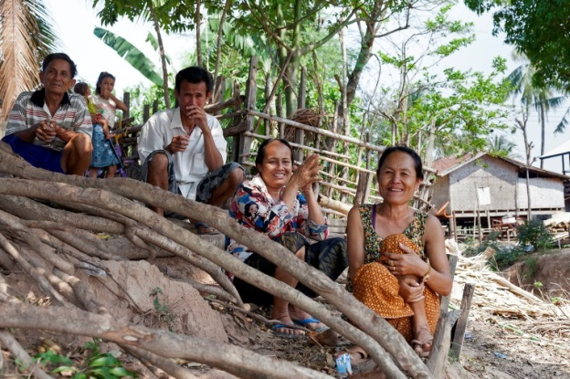
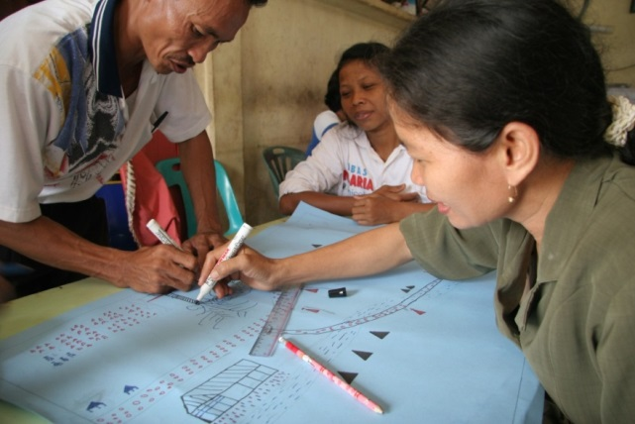
Gender and Diversity Regional TOT
Outcome 1
Increased knowledge and understanding and practical ways to integrate gender and diversity
Outcome 2
Create a reference pool of trainers in the region
Outcome 3
Increase awareness of tools and resources available to support gender and diversity integration

Slide 9
Gender and Diversity for Resilience Toolkit
Burmese
Indonesia Bahasa
Khmer
Laotian
Malay
Tagalog
Tetum
Thai
Vietnamese
English
Comprehensive but selective set of resources
Internal and external to the Movement
Hosted on SEARDs online library
Summary information in nine regional languages
Ready by October and resources will be used during the TOT
A link will be distributed in advance of the TOT for feedback from National Societies

Slide 10
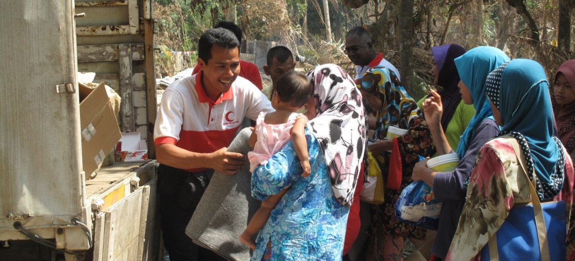
Annual Gender and Diversity Network meeting
Identify expectations for the Network and its structure e.g. meetings and communications
Express expectations for being a National Society Focal Point for Gender and Diversity
Elect a chair person and identify how the network members will support the chairperson in their role
Develop some key action points
for the coming year

Slide 11
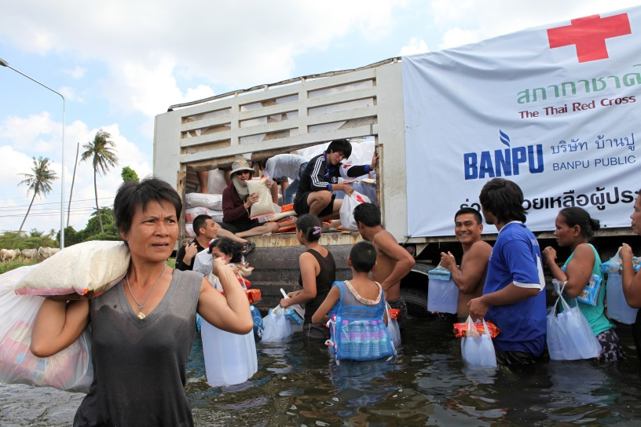
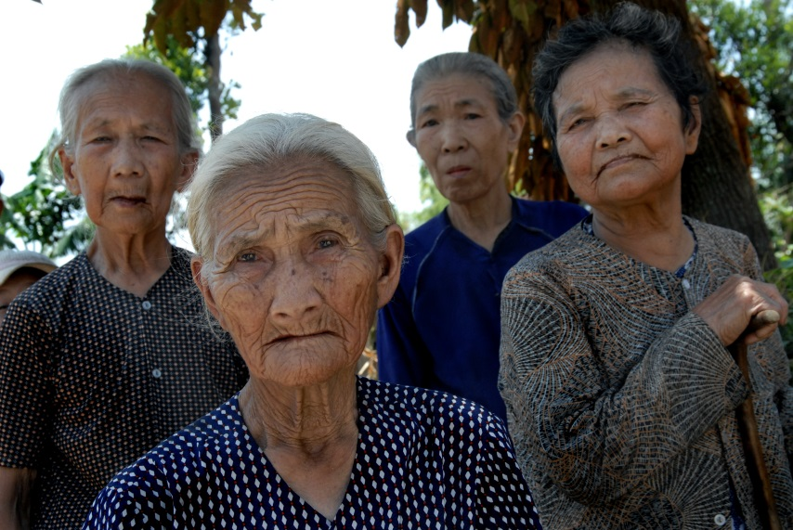
Any other questions?
Thank you very much!

