Slide 1
Introduction to the Checklist on Law and Disaster Risk Reduction
Regional Disaster Law Forum
Southeast Asia
10 -11 June, 2015

Slide 2

Overview
Why legal frameworks for DRR are important
The Checklist on Law and DRR (background, purpose, consultation process etc.)
Issues addressed in the Checklist
Links with climate change
Your feedback!

Slide 3
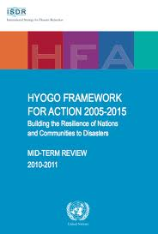
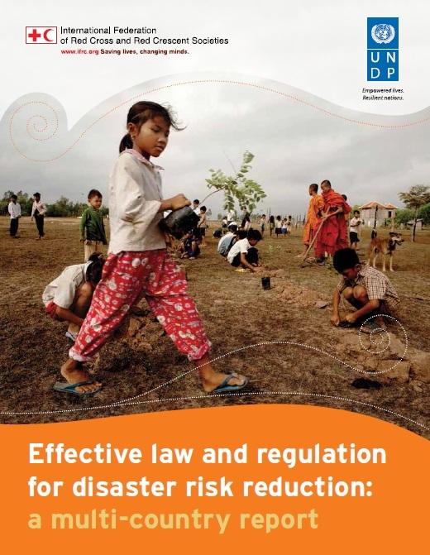
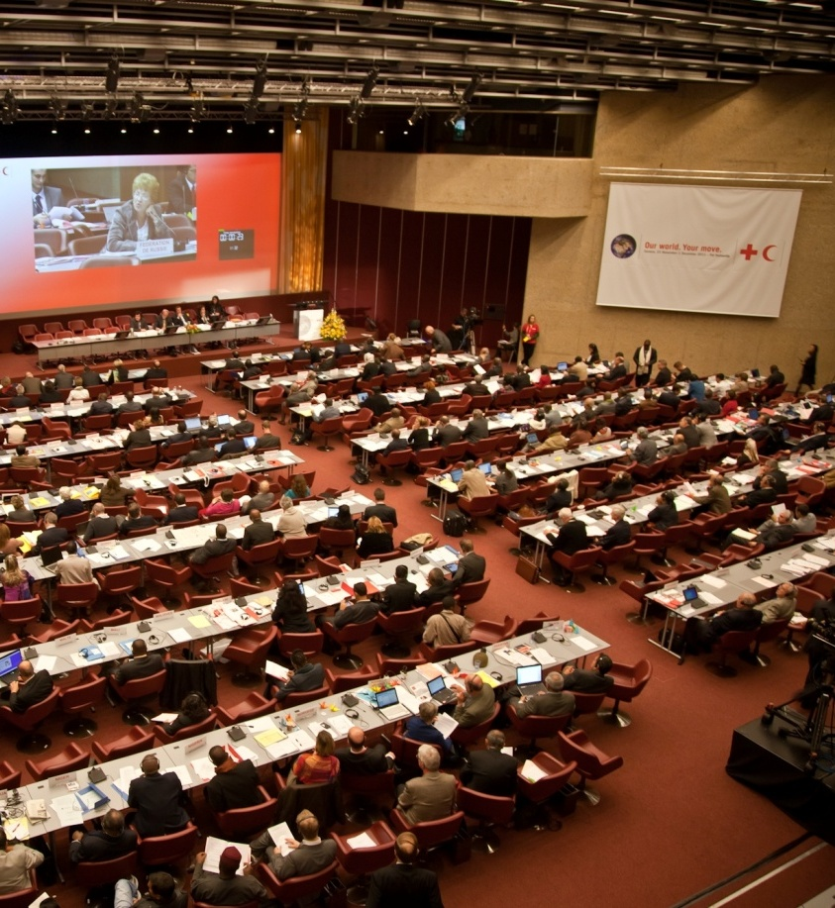
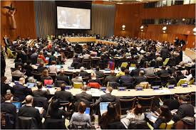
Background to the Checklist
  HFA Priority 1: make DRR a national and local priority through: “policy, legislative and institutional frameworks for disaster risk reduction”
A checklist was envisaged as the second product under the UNDP/IFRC project
  International Conference of the Red Cross and Red Crescent in 2011
  Resolution 7 and SEA pledge
Sendai Framework for DRR Priority 2: strengthening disaster risk governance

Slide 4
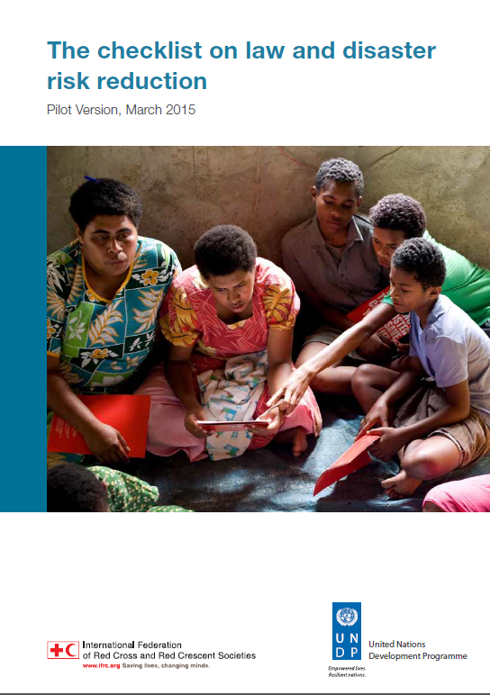
What is the checklist?
A succinct and easy tool to support the strengthening of legal frameworks for DRR by:
    Drawing on key findings of the multi-country study ‘Effective law and regulation for DRR’
    Guiding a review and revision process of laws and regulations for DRR

Slide 5
Who is the Checklist for?
Lawmakers
Implementing officials
National RCRC societies
UNDP country offices
Other DRR advocates

Slide 6

What is the handbook?
The handbook is currently being drafted to provide explanation and more detailed guidance.
It will include:
  explanations of why each question was chosen based on findings of the Multi-Country Study
  guiding questions to strengthen the assessment or ‘legal mapping’
  examples of good practice from different countries based on the findings of the IFRC/UNDP study

Slide 7

The Process
Consultations held 2012 – 2014 to discuss the draft checklist (including in KL for Asia Pacific)
Pilot version launched at WCDRR, Sendai 2015
Plan for the initial checklist to be used by 5 countries in different regions
This process will differ according to country context but will generally include:
    Legal mapping/research process
    Multi-stakeholder dialogue and consultation on priority areas for focus
    Feedback on the checklist
Aim is to conduct these projects between March and November 2015

Slide 8
Launch!
A key topic to be addressed at the 32nd International Conference of the Red Cross and Red Crescent
Formal adoption of the Checklist by states and components of the RCRC Movement by a resolution.
Once launched, develop trainings and further technical assistance projects using the Checklist

Slide 9
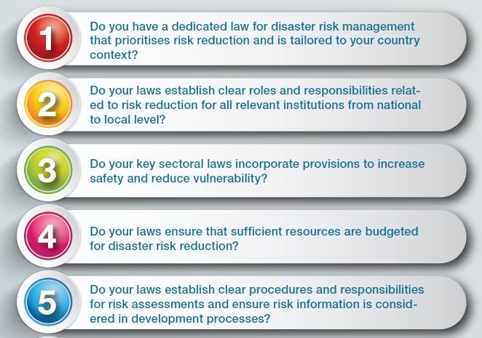
The checklist questions...

Slide 10
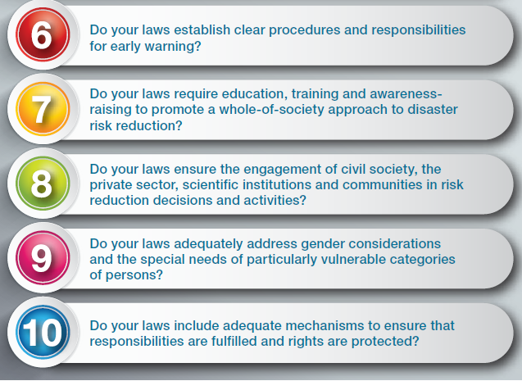
The checklist questions

Slide 11
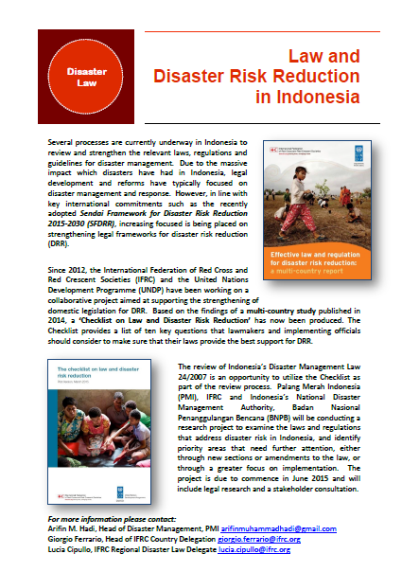
Opportunities to use the Checklist in Southeast Asia
Indonesia: planning for a DRR and Law project; use the checklist for the review of national DM law
Philippines: can use the checklist to review the national DRRM law (‘sunset review’)
Lao PDR: developing new law on DM and climate change; can use the checklist as part of this process
Timor Leste: developing a new DM law; can also use the checklist to consider how to address DRR
….also an opportunity for partnerships e.g. NS, IFRC, government, and UNDP

Slide 12
Feedback on the checklist and initial reactions
What feedback would you offer to improve the checklist?
Does it sound like a useful tool?
For more info go to www.drr-law.org

Slide 13
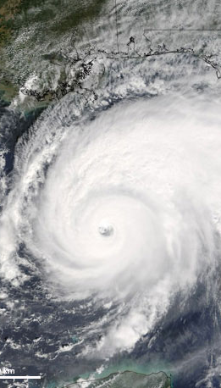
Links with climate change
Climate change adaptation measures are increasingly recognised as overlapping with many DRR measures, and vice versa.
Research has demonstrated, however, that institutions and legislation for climate change are often very separate to those assigned for disaster risk reduction and management.
To promote the multi-sectoral approach that is needed for both effective disaster risk reduction and climate change adaption, check whether your DRM law specifies mechanisms for better coordination and integration (e.g. through institutional mandates or activities).

